Slide 1
Group No. 2
IoT Based Segregation and Packaging Assembly Line
using RFID
Group Members:
Apeksha Kulkarni (30)
Lakshyajit Patra (51)
Dhaval Potdar(53)
Yash Vig (67)
PROJECT GUIDE: MR. ABHISHEK CHAUDHARI (Assistant Professor, Department of Electronics)
1

Slide 2
Introduction
Up until recently, before RFID based applications were introduced, there were labels being slapped on
palettes and cartons in warehouses of consumer goods manufacturers, in preparation to shipment to
warehouses of suppliers around the world.
The early Label based compliance programs never matured as the technology was not reliable at the
time. The process of tracking goods on the assembly line by the use of barcodes on cartons and casings
was not fast enough and required Line of Sight with the barcode readers.
Also high speed assembly lines were difficult to implement. Nowadays, with 100% read rates,
Passive RFID is generating massive amount of data and creating real efficiency in the Warehouses now.
Our project on the above idea, includes building of an IoT based smart Packaging Assembly Line.
The simulation will be done on a conveyer belt that we will build to mimic an assembly line in industry.
The goods will be automatically packed at the end of the line. Tracking and segregation of goods will be
done based on the values of the RFID Tags on goods. The data will automatically be uploaded to the
cloud and shall be used for tracking and cross-checking the final packed palette of products.
2

Slide 3
ADVANTAGES OF RFID OVER BARCODE
The backbone of our project is the higher applicability and convenience of RFID over Barcode Technology.
The following are the a points that make RFID the right choice for Industry 4.0:
Source: https://www.peerbits.com/blog/warehouse-smart-inventory-management-solution.html/amp
Attribute | RFID | Barcode
Read Rate | High throughput. Multiple (>100) Tags can be read simultaneously. | Very low throughput. Tags can only be read manually, one at a time.
Line of Sight | Not Required | Definitely Required
Human Capital | Virtually none. Once up and running, the system is completely automated. | Large requirements. Laborers must scan each tag.
Read/Write Capability | Ability to read, write, modify, update. | Read only.
Durability | High. Much better protected in harsh environment. | Low. Cannot be read if dirty and greasy.
Security | High. Difficult to replicate | Low. Much easier to counterfeit.
Event Triggering | Capable | Not Capable.
3

Slide 4
Literature Review: Reference Papers
1. Smart Warehouse: An RFID-IoT Approach
https://ijarcce.com/wp-content/uploads/2015/10/IJARCCE-106.pdf
Firstly, a RFID sensor node is introduced, which consists of an ordinary sensor connected to a passive
RFID tag over the I2C interface of the microprocessor present inside the tag. The sensor node is employed
in warehouse for different functionalities and the sensing information is then collected by an overhead RFID
reader. In doing so, we make use of the present infrastructure which includes the deployed overhead RFID
readers those are used for the locationing of the items inside a warehouse. The data from the readers is
relayed to different platforms depending upon the requirements.
2. An RFID-Enables Automated Warehouse System
https://www.ijmmm.org/vol3/212-H028.pdf
A typical RFID reader is a microcontroller-based radio transceiver that powers an RFID tag using the time-
varying electro-magnetic fields (EMF) generated from an RFID antenna. Once an RFID tag is powered, it
can receive commands from an RFID reader. An RFID tag is composed of two essential components: an
antenna and a computer chip. The computer chip is used to store data while the antenna allows data
communication between an RFID tag and an RFID reader through a wireless signal transmission. Each
RFID tag has a unique identification (UID), which can be used to uniquely identify an RFID tagged item.
The collected RFID information data by an RFID reader can be transferred to a host PC as database for
data processing and storage.

Slide 5
Literature Review: References (contd.)
3. RFID Technology Applied in Warehouse Management System
https://www.researchgate.net/publication/4370815_RFID_Technology_Applied_in_Warehouse_
Management_System
The RFID technology has a lot of advantage, such as simultaneous collection of large quantities of data,
without any requirement on accurate counter-position, which makes the enterprise free of daily mass
repeating operations. The warehouse management system (WMS) based on RFID can collect, transfer,
check, and update mass data on daily frequent goods entry and delivery, thus the labor intensity will be
decreased, errors like fault scanning, miss scanning, re-scanning in the repeating manual operations can
also be avoided, while the efficiency and accuracy will be improved a lot. With development of the RFID
technology, reduction of costs, gradual unification of the standards, decrease of the error rate, the effective
combination of WMS and RFID will become one of the key factors to improve the competitive power of
enterprises and the efficiency of the supply chain.

Slide 6
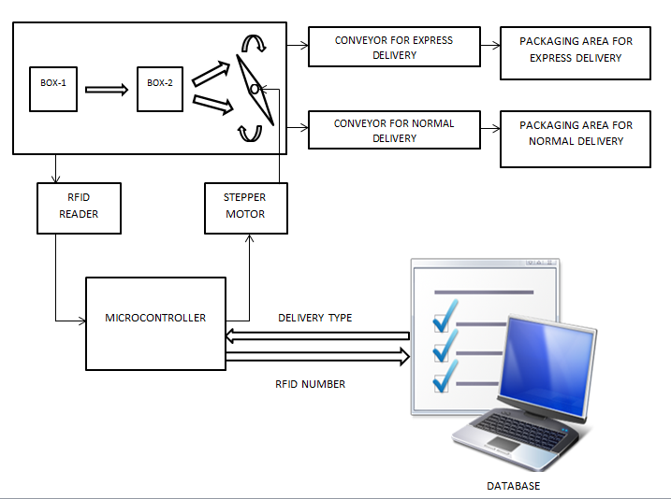
Block Diagram

Slide 7
SOFTWARE ALGORITHM
1. Start by sending the parcel attached with an RFID tag on the conveyor, to be read by the RFID reader.
2. The RFID number is sent to the database containing Customer Id, Delivery Type and RFID Number fields
and attached randomly.
3. The corresponding type of delivery information is retrieved.
4. Check the corresponding delivery type. Is it Express Delivery or Normal Delivery?
5. Depending on the delivery type, the microcontroller informs the stepper motor.
6. The stepper motor controls the flap and accordingly adjusts it to direct the parcel towards a different
conveyor belt.
7. The parcel is moved towards the packaging section.
8. A rod wound up with plastic is used which rotates by virtue of DC motors.
9. The parcel is rotated in order to be wrapped by the rotating plastic system.
10. The parcel is ready for delivery.

Slide 8
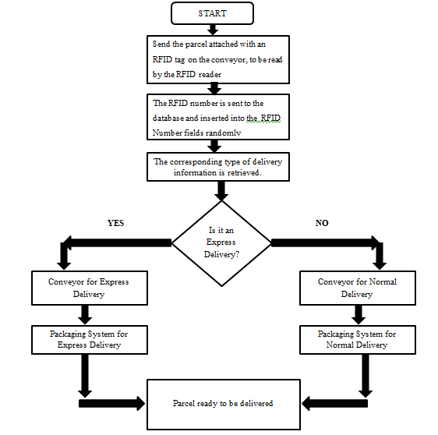
FLOWCHART

Slide 9
Hardware/Software Scheme
Hardware:
MFRC 522 RFID Tag Reader
Node MCU ESP8266 12e Model
DC Motors
Stepper Motor NEMA 17 Model
Software:
Embedded C(Arduino IDE)
Firebase by Google
Node JS
Eagle
9

Slide 10
Work Done
Literature Review Completed. A number of online articles and technical papers gathered for reference.
The RFID tags were successfully scanned and the Unique Identifier of each of the tags was retrieved.
A real time database was created using Firebase by Google.
The Unique Tag ID was successfully stored in the database wirelessly using ESP8266
Node MCU Module.
Further plan of implantation was successfully defined and the issues with the current hardware
configuration were recognized.
10

Slide 11
Plan of Implementation
SEM | Duration | JOB TO BE COMPLETED
VII | Aug 2018 | Gathering enough information about the topic and reading about it from all the necessary and possible sources. Doing a Literature Survey.
VII | Sept/Oct 2018 | Interfacing the sensors with microcontroller and testing the data stream to IoT cloud. Logging data into Database.
VII | Nov 2018
VII | Dec 2018 | Making a conveyer belt to resemble an assembly line. Making the packaging assembly.
VIII | Jan 2019 | Testing of the entire assembly with the database. Troubleshooting and debugging.
VIII | Feb 2019 | Final prototype review.
11

Slide 12
References
[1]. RFID Technology Applied in Warehouse Management System. South China University of Technology.
IEEE Xplore, September 2008.
[2]. Smart Warehouse: An RFID-IoT Approach. International Journal of Advanced Research in Computer
and Communication Engineering. Vol. 4, Issue 9, September 2015.
[3]. An RFID-Enabled Automated Warehouse. International Journal of Materials, Mechanics and Manufact-
uring. Vol. 3, Issue 4, November 2015.
[4]. How does a Warehouse Smart Inventory Management System perform?
https://www.peerbits.com/blog/warehouse-smart-inventory-management-solution.html/amp
[5]. RFID smart tag for traceability and cold chain monitoring of foods: Demonstration in an intercontinental
fresh fish logistic chain. Journal of Food Engineering. Vol. 93, Issue 4, August 2009.
https://www.sciencedirect.com/science/article/pii/S0260877409000661
[6.] ESP8266EX Datasheet by Espressif Systems IOT Team. Version 4.3, 2015.
[7.]MFRC522 Product Datasheet. Rev. 3.9, April 2016.
12

